Slide 1
Group Theory and Symmetry
July 11, 2022
Ally Burke

Slide 2
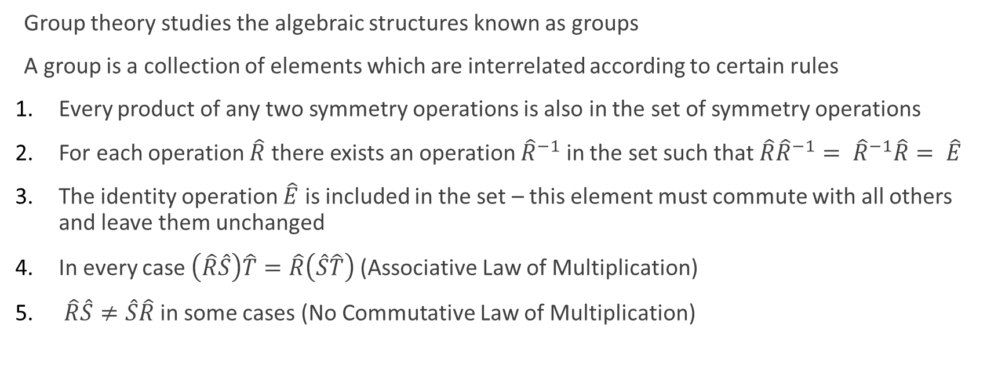
Group Theory
Group theory studies the algebraic structures known as groups
A group is a collection of elements which are interrelated according to certain rules
Every product of any two symmetry operations is also in the set of symmetry operations
For each operation $\hat{R}$ there exists an operation ${\hat{R}}^{−1}$ in the set such that$\hat{R}{\hat{R}}^{−1}= {\hat{R}}^{−1}\hat{R}= \hat{E}$
The identity operation $\hat{E}$ is included in the set – this element must commute with all others and leave them unchanged
In every case $\left(\hat{R}\hat{S}\right)\hat{T}=\hat{R}\left(\hat{S}\hat{T}\right)$ (Associative Law of Multiplication)
$\hat{R}\hat{S}≠\hat{S}\hat{R}$ in some cases (No Commutative Law of Multiplication)

Slide 3
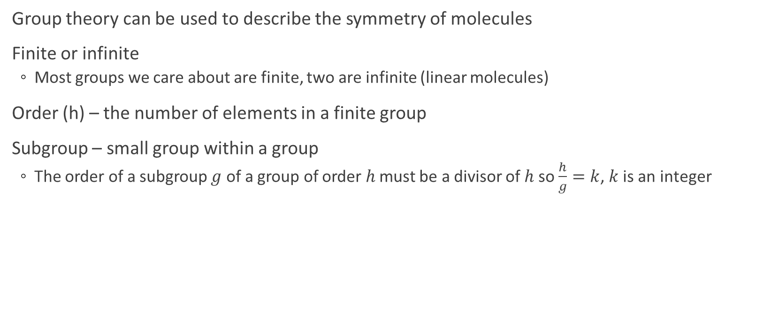
Groups
Group theory can be used to describe the symmetry of molecules
Finite or infinite
Most groups we care about are finite, two are infinite (linear molecules)
Order (h) – the number of elements in a finite group
Subgroup – small group within a group
The order of a subgroup $g$ of a group of order $h$ must be a divisor of $h$so $\frac{h}{g}=k$, $k$ is an integer

Slide 4
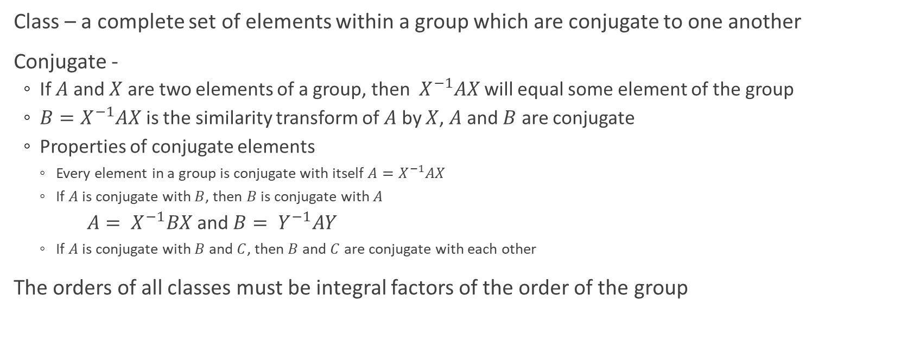
Groups
Class – a complete set of elements within a group which are conjugate to one another
Conjugate -
If $A$ and $X$ are two elements of a group, then $X^{−1}AX$ will equal some element of the group
$B=X^{−1}AX$ is the similarity transform of $A$ by $X$, $A$ and $B$ are conjugate
Properties of conjugate elements
Every element in a group is conjugate with itself $A=X^{−1}AX$
If $A$ is conjugate with $B$, then $B$ is conjugate with $A$
$A= X^{−1}BX$ and $B= Y^{−1}AY$
If $A$ is conjugate with $B$ and $C$, then $B$ and $C$ are conjugate with each other
The orders of all classes must be integral factors of the order of the group

Slide 5
Molecular Symmetry
Molecules have varying levels of symmetry
To utilize this symmetry, we need some mathematical criteria to establish different symmetry elements/operators into groups
Symmetry elements vs. symmetry operators
Symmetry element – a geometrical entity such as a line, a plane, or a point, with respect to which one or more symmetry operations may be carried out
Symmetry operation – a movement of a body such that, after the movement has been carried out, every point of the body is coincident with an equivalent point (or perhaps the same point) of the body in its original orientation

Slide 6
Symmetry elements
Symmetry Element | Symmetry Operation
Identity (E)
Proper axis (C_{n}) | Rotation of atoms about an axis
Plane (σ) | Reflection in the plane
Center of inversion (i) | Inversion of all atoms through the center
Improper axis (S_{n}) | Rotation of atoms about an axis followed by reflection in a plane perpendicular to the rotation axis
Cotton, F. Albert. (1963) Chemical Applications of Group Theory.

Slide 7


Identity ($\hat{E}$)
$\hat{E}\left[\left(x,y,z\right)\right]=\left(x,y,z\right)$
Included to make our point groups complete mathematical groups
Cotton, F. Albert. (1963) Chemical Applications of Group Theory.

Slide 8
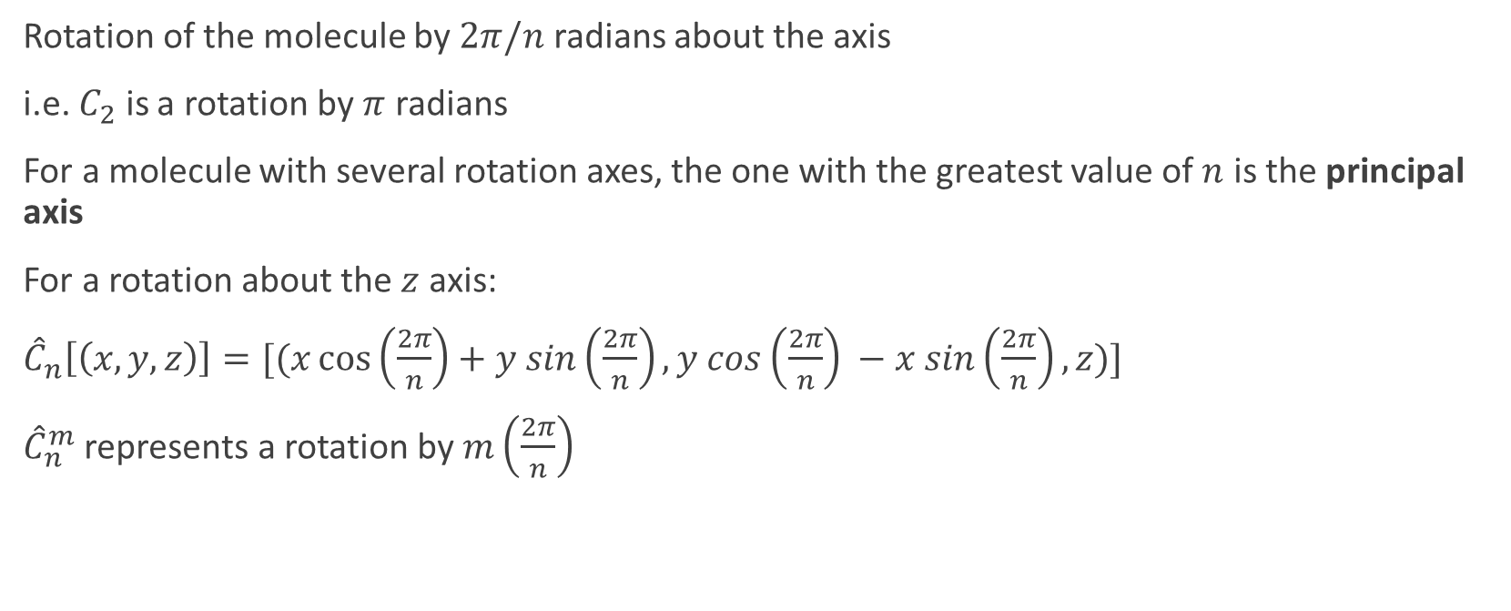

Axes of Rotation ($\hat{C}n$)
Rotation of the molecule by $2π/n$ radians about the axis
i.e. $C_{2}$ is a rotation by $π$ radians
For a molecule with several rotation axes, the one with the greatest value of $n$ is the principal axis
For a rotation about the $z$ axis:
${\hat{C}}_{n}\left[\left(x,y,z\right)\right]=[(x\cos\left(\frac{2π}{n}\right)+y sin\left(\frac{2π}{n}\right), y cos\left(\frac{2π}{n}\right) −x sin\left(\frac{2π}{n}\right), z)]$
${\hat{C}}_{n}^{m}$ represents a rotation by $m\left(\frac{2π}{n}\right)$
Cotton, F. Albert. (1963) Chemical Applications of Group Theory.

Slide 9
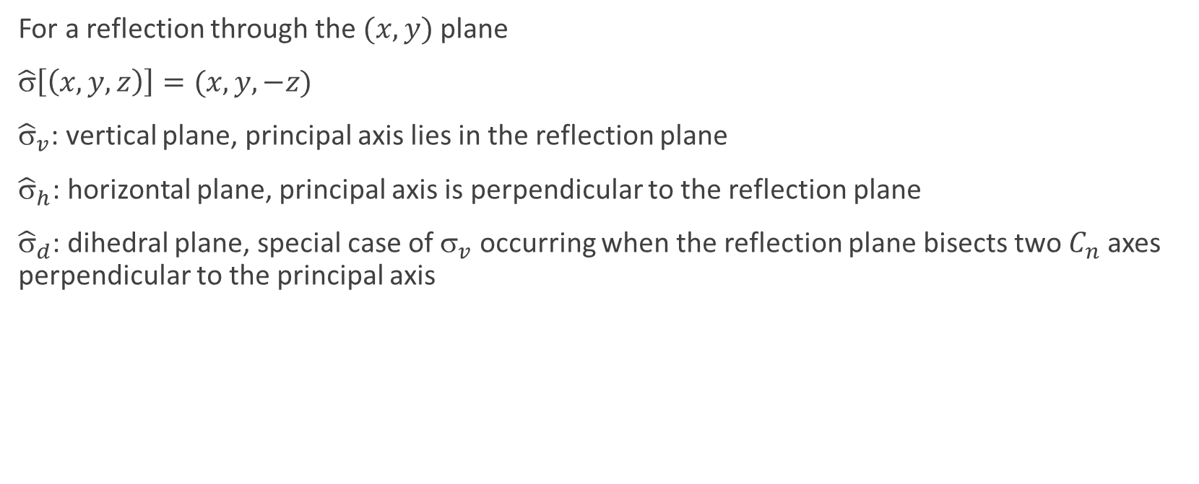

Reflection Planes ($\hat{σ}$)
For a reflection through the$(x,y)$plane
$\hat{σ}\left[\left(x,y,z\right)\right]=(x,y,−z)$
${\hat{σ}}_{v}$: vertical plane, principal axis lies in the reflection plane
${\hat{σ}}_{h}$: horizontal plane, principal axis is perpendicular to the reflection plane
${\hat{σ}}_{d}$: dihedral plane, special case of $_{v}$ occurring when the reflection plane bisects two $C_{n}$ axes perpendicular to the principal axis
Cotton, F. Albert. (1963) Chemical Applications of Group Theory.

Slide 10


Inversion ($\hat{i}$)
For every point:
$\hat{i}\left[\left(x,y,z\right)\right]=[\left(−x,−y,−z\right)]$
Cotton, F. Albert. (1963) Chemical Applications of Group Theory.

Slide 11
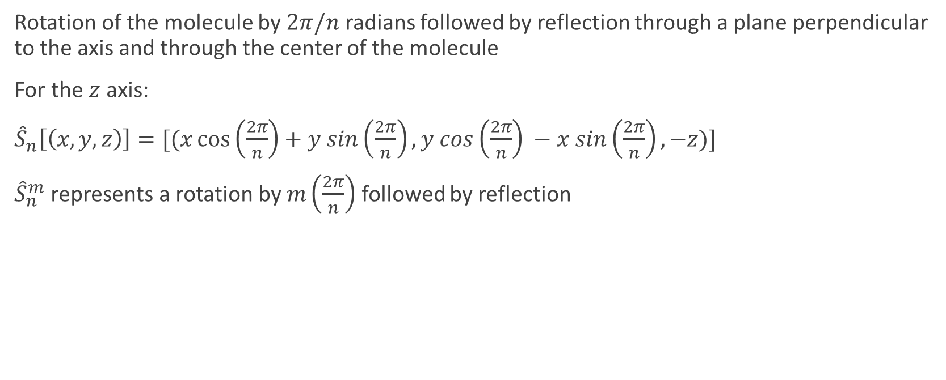

Improper Rotation ($\hat{S}n$)
Rotation of the molecule by $2π/n$ radians followed by reflection through a plane perpendicular to the axis and through the center of the molecule
For the $z$ axis:
${\hat{S}}_{n}\left[\left(x,y,z\right)\right]=[(x\cos\left(\frac{2π}{n}\right)+y sin\left(\frac{2π}{n}\right), y cos\left(\frac{2π}{n}\right) −x sin\left(\frac{2π}{n}\right), −z)]$
${\hat{S}}_{n}^{m}$ represents a rotation by $m\left(\frac{2π}{n}\right)$ followed by reflection
Cotton, F. Albert. (1963) Chemical Applications of Group Theory.

Slide 12
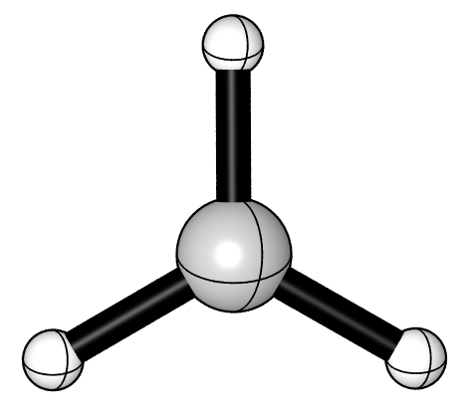
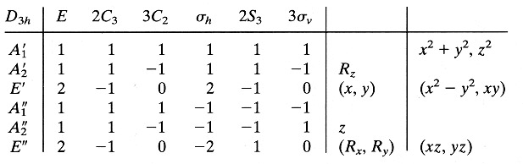
Identifying the point group of a molecule
Compile list of symmetry elements

Slide 13
Character Tables
The elements of a point group are laid out in character tables

Slide 14
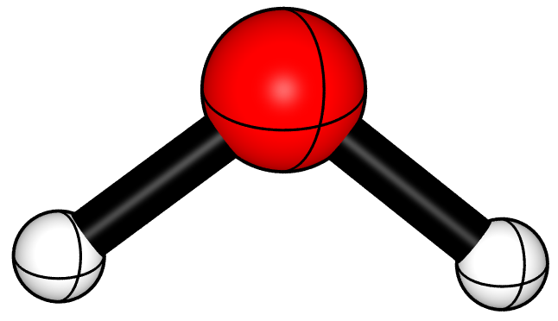
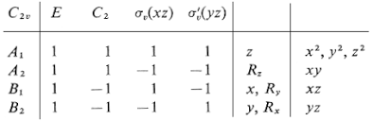

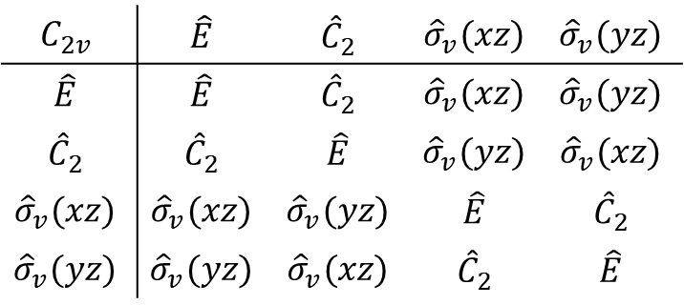
Prove a point group is a mathematical group
1. Every product of symmetry operations is also in the set of symmetry operations
$\hat{T}=\hat{R}\hat{S}$ $\hat{S}$
$\hat{R}$
z
y
$$C_{2v}$$ | $$\hat{E}$$ | $${\hat{C}}_{2}$$ | $${\hat{σ}}_{v}(xz)$$ | $${\hat{σ}}_{v}(yz)$$
$$\hat{E}$$ | $$\hat{E}$$ | $${\hat{C}}_{2}$$ | $${\hat{σ}}_{v}(xz)$$ | $${\hat{σ}}_{v}(yz)$$
$${\hat{C}}_{2}$$ | $${\hat{C}}_{2}$$ | $$\hat{E}$$ | $${\hat{σ}}_{v}(yz)$$ | $${\hat{σ}}_{v}(xz)$$
$${\hat{σ}}_{v}(xz)$$ | $${\hat{σ}}_{v}(xz)$$ | $${\hat{σ}}_{v}(yz)$$ | $$\hat{E}$$ | $${\hat{C}}_{2}$$
$${\hat{σ}}_{v}(yz)$$ | $${\hat{σ}}_{v}(yz)$$ | $${\hat{σ}}_{v}(xz)$$ | $${\hat{C}}_{2}$$ | $$\hat{E}$$

Slide 15
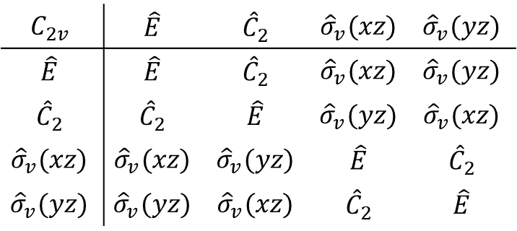

Prove a point group is a mathematical group
2. For each operation $\hat{R}$ there exists an operation ${\hat{R}}^{−1}$ in the set such that
$\hat{R}{\hat{R}}^{−1}= {\hat{R}}^{−1}\hat{R}= \hat{E}$
$\hat{T}=\hat{R}\hat{S}$ $\hat{S}$
$\hat{R}$
z
y
$$C_{2v}$$ | $$\hat{E}$$ | $${\hat{C}}_{2}$$ | $${\hat{σ}}_{v}(xz)$$ | $${\hat{σ}}_{v}(yz)$$
$$\hat{E}$$ | $$\hat{E}$$ | $${\hat{C}}_{2}$$ | $${\hat{σ}}_{v}(xz)$$ | $${\hat{σ}}_{v}(yz)$$
$${\hat{C}}_{2}$$ | $${\hat{C}}_{2}$$ | $$\hat{E}$$ | $${\hat{σ}}_{v}(yz)$$ | $${\hat{σ}}_{v}(xz)$$
$${\hat{σ}}_{v}(xz)$$ | $${\hat{σ}}_{v}(xz)$$ | $${\hat{σ}}_{v}(yz)$$ | $$\hat{E}$$ | $${\hat{C}}_{2}$$
$${\hat{σ}}_{v}(yz)$$ | $${\hat{σ}}_{v}(yz)$$ | $${\hat{σ}}_{v}(xz)$$ | $${\hat{C}}_{2}$$ | $$\hat{E}$$

Slide 16

Prove a point group is a mathematical group
3. The identity operation $\hat{E}$ is included in the set
$\hat{T}=\hat{R}\hat{S}$ $\hat{S}$
$\hat{R}$
z
y
$$C_{2v}$$ | $$\hat{E}$$ | $${\hat{C}}_{2}$$ | $${\hat{σ}}_{v}(xz)$$ | $${\hat{σ}}_{v}(yz)$$
$$\hat{E}$$ | $$\hat{E}$$ | $${\hat{C}}_{2}$$ | $${\hat{σ}}_{v}(xz)$$ | $${\hat{σ}}_{v}(yz)$$
$${\hat{C}}_{2}$$ | $${\hat{C}}_{2}$$ | $$\hat{E}$$ | $${\hat{σ}}_{v}(yz)$$ | $${\hat{σ}}_{v}(xz)$$
$${\hat{σ}}_{v}(xz)$$ | $${\hat{σ}}_{v}(xz)$$ | $${\hat{σ}}_{v}(yz)$$ | $$\hat{E}$$ | $${\hat{C}}_{2}$$
$${\hat{σ}}_{v}(yz)$$ | $${\hat{σ}}_{v}(yz)$$ | $${\hat{σ}}_{v}(xz)$$ | $${\hat{C}}_{2}$$ | $$\hat{E}$$

Slide 17

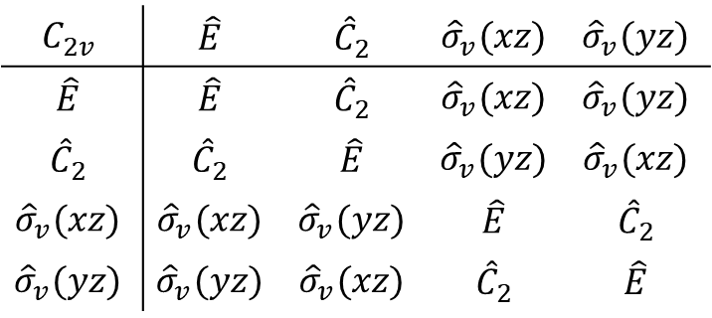
Prove a point group is a mathematical group
4. In every case $\left(\hat{R}\hat{S}\right)\hat{T}=\hat{R}\left(\hat{S}\hat{T}\right)$ (Associative Law of Multiplication)
$$\left({\hat{C}}_{2}{\hat{σ}}_{v}(xz)\right){\hat{σ}}_{v}(yz)={\hat{C}}_{2}\left({\hat{σ}}_{v}(xz){\hat{σ}}_{v}(yz)\right)$$
z
y
$$C_{2v}$$ | $$\hat{E}$$ | $${\hat{C}}_{2}$$ | $${\hat{σ}}_{v}(xz)$$ | $${\hat{σ}}_{v}(yz)$$
$$\hat{E}$$ | $$\hat{E}$$ | $${\hat{C}}_{2}$$ | $${\hat{σ}}_{v}(xz)$$ | $${\hat{σ}}_{v}(yz)$$
$${\hat{C}}_{2}$$ | $${\hat{C}}_{2}$$ | $$\hat{E}$$ | $${\hat{σ}}_{v}(yz)$$ | $${\hat{σ}}_{v}(xz)$$
$${\hat{σ}}_{v}(xz)$$ | $${\hat{σ}}_{v}(xz)$$ | $${\hat{σ}}_{v}(yz)$$ | $$\hat{E}$$ | $${\hat{C}}_{2}$$
$${\hat{σ}}_{v}(yz)$$ | $${\hat{σ}}_{v}(yz)$$ | $${\hat{σ}}_{v}(xz)$$ | $${\hat{C}}_{2}$$ | $$\hat{E}$$

Slide 18

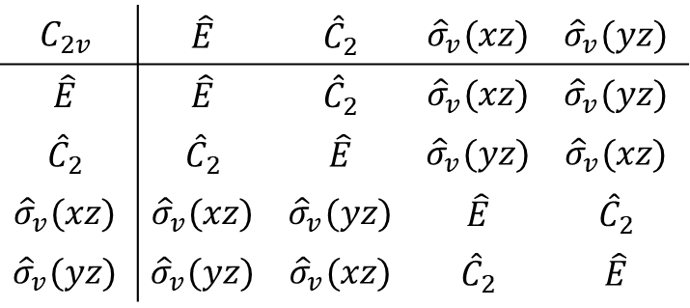
Prove a point group is a mathematical group
z
5. $\hat{R}\hat{S}≠\hat{S}\hat{R}$ in every case (No Commutative Law of Multiplication)
$C_{2v}$ is abelian, so the commutative law of multiplication holds
z
y
y
$$C_{2v}$$ | $$\hat{E}$$ | $${\hat{C}}_{2}$$ | $${\hat{σ}}_{v}(xz)$$ | $${\hat{σ}}_{v}(yz)$$
$$\hat{E}$$ | $$\hat{E}$$ | $${\hat{C}}_{2}$$ | $${\hat{σ}}_{v}(xz)$$ | $${\hat{σ}}_{v}(yz)$$
$${\hat{C}}_{2}$$ | $${\hat{C}}_{2}$$ | $$\hat{E}$$ | $${\hat{σ}}_{v}(yz)$$ | $${\hat{σ}}_{v}(xz)$$
$${\hat{σ}}_{v}(xz)$$ | $${\hat{σ}}_{v}(xz)$$ | $${\hat{σ}}_{v}(yz)$$ | $$\hat{E}$$ | $${\hat{C}}_{2}$$
$${\hat{σ}}_{v}(yz)$$ | $${\hat{σ}}_{v}(yz)$$ | $${\hat{σ}}_{v}(xz)$$ | $${\hat{C}}_{2}$$ | $$\hat{E}$$

Slide 19
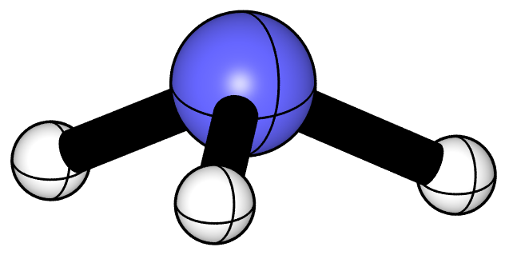
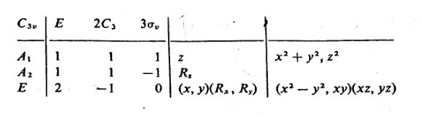

Prove a point group is a mathematical group
z
5. $\hat{R}\hat{S}≠\hat{S}\hat{R}$ in every case (No Commutative Law of Multiplication)
$${\hat{C}}_{3}{\hat{σ}}_{v}(yz)={\hat{σ}}_{v}{(yz)\hat{C}}_{3}$$
y

Slide 20
Representations of Groups
A representation of the types of groups we care about may be defined as a set of matrices, each corresponding to a single operation in the group
They may be combined the same way symmetry operations may be combined

Slide 21
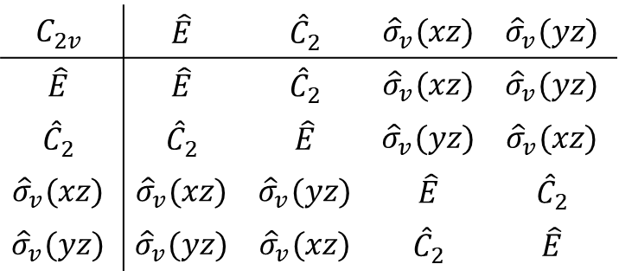
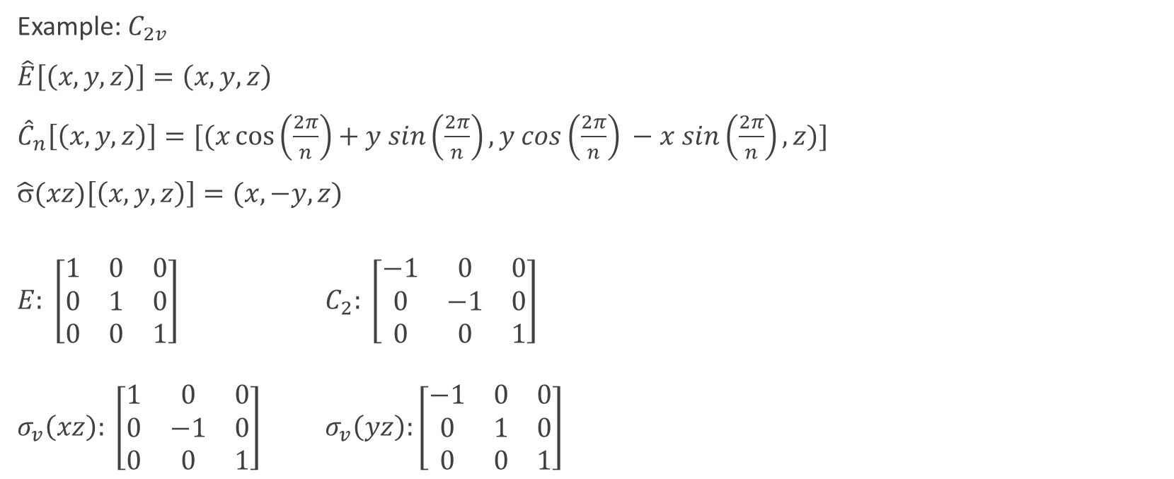
Representation Example
Example: $C_{2v}$
$\hat{E}\left[\left(x,y,z\right)\right]=\left(x,y,z\right)$
${\hat{C}}_{n}\left[\left(x,y,z\right)\right]=[(x\cos\left(\frac{2π}{n}\right)+y sin\left(\frac{2π}{n}\right), y cos\left(\frac{2π}{n}\right) −x sin\left(\frac{2π}{n}\right), z)]$
$\hat{σ}(xz)\left[\left(x,y,z\right)\right]=(x,−y,z)$
$E: \left[\begin{matrix}1 & 0 & 0 \\ 0 & 1 & 0 \\ 0 & 0 & 1\end{matrix}\right]$ $C_{2}: \left[\begin{matrix}−1 & 0 & 0 \\ 0 & −1 & 0 \\ 0 & 0 & 1\end{matrix}\right]$
$σ_{v}\left(xz\right): \left[\begin{matrix}1 & 0 & 0 \\ 0 & −1 & 0 \\ 0 & 0 & 1\end{matrix}\right]$ $σ_{v}\left(yz\right):\left[\begin{matrix}−1 & 0 & 0 \\ 0 & 1 & 0 \\ 0 & 0 & 1\end{matrix}\right]$
$$C_{2v}$$ | $$\hat{E}$$ | $${\hat{C}}_{2}$$ | $${\hat{σ}}_{v}(xz)$$ | $${\hat{σ}}_{v}(yz)$$
$$\hat{E}$$ | $$\hat{E}$$ | $${\hat{C}}_{2}$$ | $${\hat{σ}}_{v}(xz)$$ | $${\hat{σ}}_{v}(yz)$$
$${\hat{C}}_{2}$$ | $${\hat{C}}_{2}$$ | $$\hat{E}$$ | $${\hat{σ}}_{v}(yz)$$ | $${\hat{σ}}_{v}(xz)$$
$${\hat{σ}}_{v}(xz)$$ | $${\hat{σ}}_{v}(xz)$$ | $${\hat{σ}}_{v}(yz)$$ | $$\hat{E}$$ | $${\hat{C}}_{2}$$
$${\hat{σ}}_{v}(yz)$$ | $${\hat{σ}}_{v}(yz)$$ | $${\hat{σ}}_{v}(xz)$$ | $${\hat{C}}_{2}$$ | $$\hat{E}$$

Slide 22
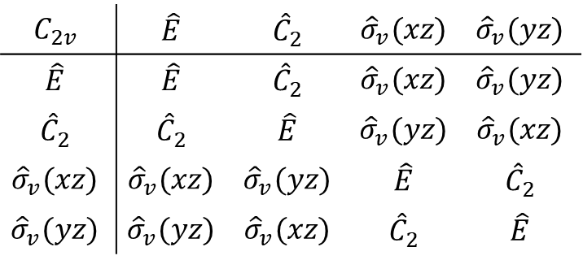
Irreducible representations
Irreducible representation (irrep) – the minimal set of the simplest possible representations of a group from which all others can be expressed
$$C_{2v}$$ | $$\hat{E}$$ | $${\hat{C}}_{2}$$ | $${\hat{σ}}_{v}(xz)$$ | $${\hat{σ}}_{v}(yz)$$
$$\hat{E}$$ | $$\hat{E}$$ | $${\hat{C}}_{2}$$ | $${\hat{σ}}_{v}(xz)$$ | $${\hat{σ}}_{v}(yz)$$
$${\hat{C}}_{2}$$ | $${\hat{C}}_{2}$$ | $$\hat{E}$$ | $${\hat{σ}}_{v}(yz)$$ | $${\hat{σ}}_{v}(xz)$$
$${\hat{σ}}_{v}(xz)$$ | $${\hat{σ}}_{v}(xz)$$ | $${\hat{σ}}_{v}(yz)$$ | $$\hat{E}$$ | $${\hat{C}}_{2}$$
$${\hat{σ}}_{v}(yz)$$ | $${\hat{σ}}_{v}(yz)$$ | $${\hat{σ}}_{v}(xz)$$ | $${\hat{C}}_{2}$$ | $$\hat{E}$$

Slide 23
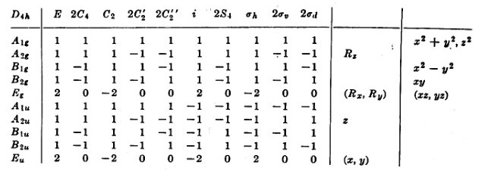
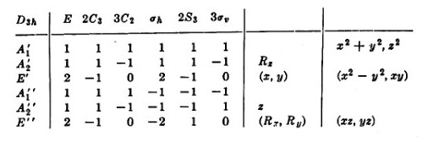
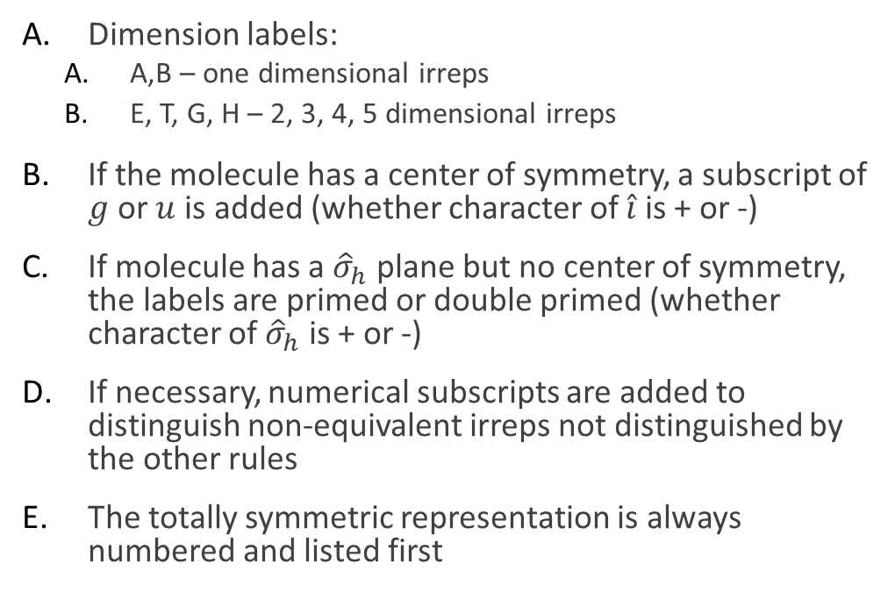
Labeling Irreducible Representations
Dimension labels:
A,B – one dimensional irreps
E, T, G, H – 2, 3, 4, 5 dimensional irreps
If the molecule has a center of symmetry, a subscript of $g$ or $u$ is added (whether character of $\hat{i}$ is + or -)
If molecule has a ${\hat{σ}}_{h}$ plane but no center of symmetry, the labels are primed or double primed (whether character of ${\hat{σ}}_{h}$ is + or -)
If necessary, numerical subscripts are added to distinguish non-equivalent irreps not distinguished by the other rules
The totally symmetric representation is always numbered and listed first

Slide 24
Irrep Rules
Consequences of the Great Orthogonality Theorem*
The sum of the squares of the dimensions of the irreps of a group is equal to the order of the group (Reminder: order = number of elements in a group)
The sum of the squares of the characters in any irrep equals the order of the group
The vectors whose components are the characters of two different irreps are orthogonal
In a given representation the characters of all matrices belonging to operations in the same class are identical
The number of irreps of a group is equal to the number of classes in the group
*F.A. Cotton, Chemical Applications of Group Theory, pp. 78-86

Slide 25
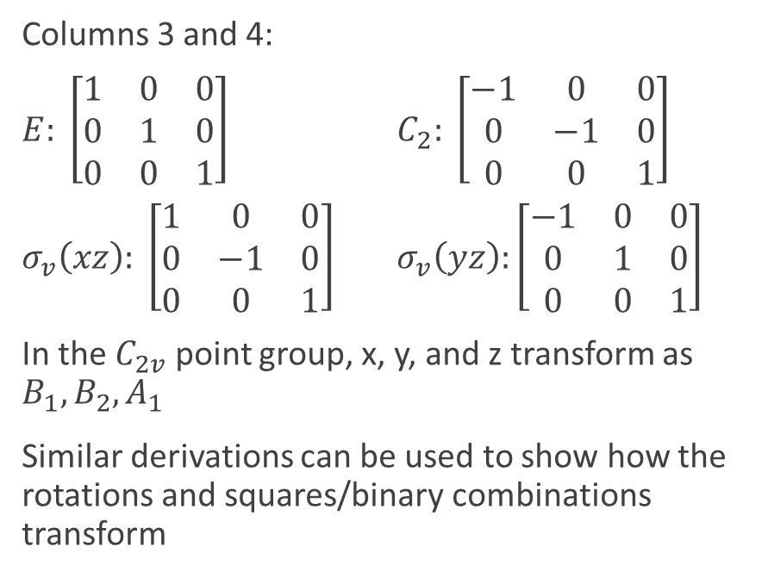
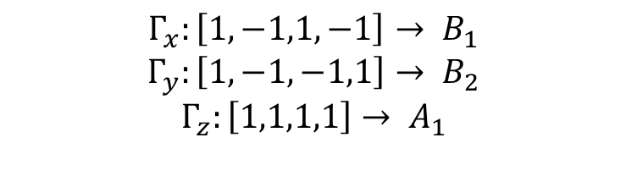
Other Character Table Details
Columns 3 and 4:
$E: \left[\begin{matrix}1 & 0 & 0 \\ 0 & 1 & 0 \\ 0 & 0 & 1\end{matrix}\right]$ $C_{2}: \left[\begin{matrix}−1 & 0 & 0 \\ 0 & −1 & 0 \\ 0 & 0 & 1\end{matrix}\right]$
$σ_{v}\left(xz\right): \left[\begin{matrix}1 & 0 & 0 \\ 0 & −1 & 0 \\ 0 & 0 & 1\end{matrix}\right]$ $σ_{v}\left(yz\right):\left[\begin{matrix}−1 & 0 & 0 \\ 0 & 1 & 0 \\ 0 & 0 & 1\end{matrix}\right]$
In the $C_{2v}$ point group, x, y, and z transform as $B_{1}, B_{2}, A_{1}$
Similar derivations can be used to show how the rotations and squares/binary combinations transform
$$Γ_{x}:\left[1,−1,1,−1\right]→ B_{1}$$
$$Γ_{y}:\left[1,−1,−1,1\right]→ B_{2}$$
$$Γ_{z}:\left[1,1,1,1\right]→ A_{1}$$

Slide 26
What is group theory useful for?
Symmetry can:
Tell you about the qualitative features of a problem
Tell you how many energy states a system has and what interactions and transitions between them may occur
“What is possible and what is completely impossible?” (can’t tell how likely the possible things are to take place)
Tell you, in principle, two states of a system must differ in energy (size of the difference can only be determined by computation or measurement)
Tell you that only certain absorption bands in the electronic or vibrational spectrum of a molecule may occur (to determine where and with what intensity, computations/measurements are required)

Slide 27
Resources
Resources:
Chemical Applications of Group Theory by F. Albert Cotton
Symmetry @ Otterbein https://symotter.org/gallery
Dr. Allen’s notes from CHEM 8950

